Slide 1
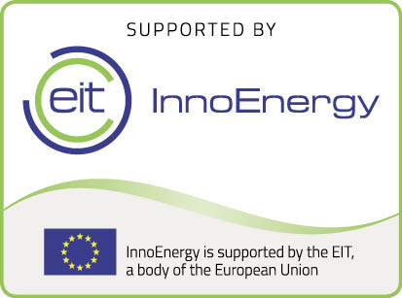
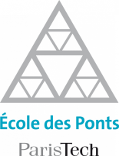
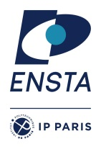
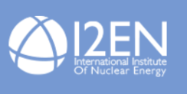
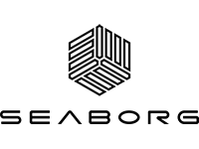
Contacts :
Emilie Ferrié: emilie.ferrie@grenoble-inp.fr
Fanny Hébert: fanny.hebert@grenoble-inp.fr
Luc Salvo: luc.salvo@grenoble-inp.fr
Web site
www.innoenergy.com/emine

Slide 2
Objectives : Train students to become inescapable engineers and researchers in the future to solve energy issues in the world with a solid background in nuclear.
Students Background: Bachelor in physics, materials, nuclear, chemistry. Scholarships for the best students.
Support: EIT, I2EN, ENEN, Industrial partners

Slide 3
Year 1
At UPC or KTH
+
summer school with the ESADE business school, in Barcelona
Nuclear Engieering
Components and materials
Regulations and safety
Power plant Management
Reactors physics …
Radiation protection
Safety
Nuclear Physics
Waste storage (summer school)
….
Innovation and energy
2 weeks summer school
Year 2
At Grenoble INP or Université Paris Saclay
+
5 months master thesis
Material Sciences for nuclear energy
+ 2 weeks at CEA Cadarache
+ 2 weeks at EDF R&D
- Nuclear Reactor Physics and Engineering
- Decommissioning and Waste management,
- Fuel cycle
- Nuclear Plant Design,
- Operation
5 months Master Thesis
Double
Diploma

Slide 4
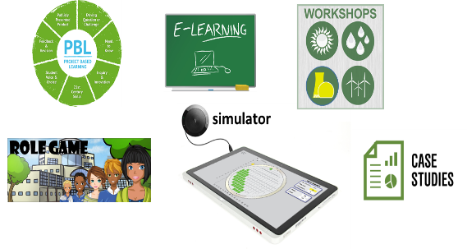
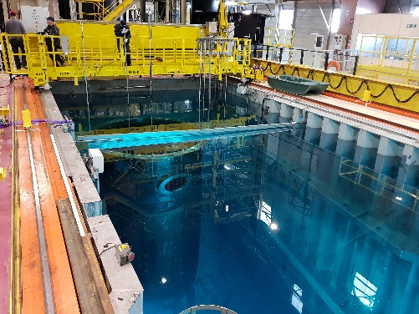
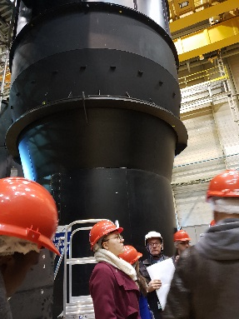
Top level European universities : KTH, UPC, Grenoble INP, Paris Saclay (engineering schools)
Labeling and coaccredidation : EIT label (5 years) + I2EN (5 years) + INSTN accreditation (France)
New pedagogial methods and societal challenges :, Project Based Learning, on site course (EDF & CEA) and specific session (summer school, work on simulators), visits, cases studies…
Innovation and management: 2 weeks summer school at ESADE business school, Barcelona (Innovation & Entrepreneurship Journey)
Strong industrial involvement of important industrial company in nuclear: curriculum, courses, on site courses, master thesis offers, jobs. More than 10 ECTS each year. Learning expedition EDF FRAMATOME, ENDESA …

Slide 5
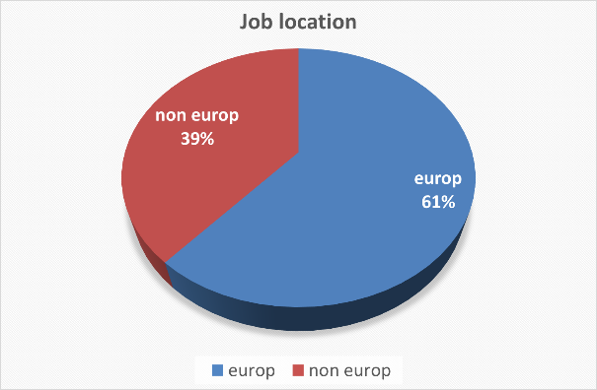
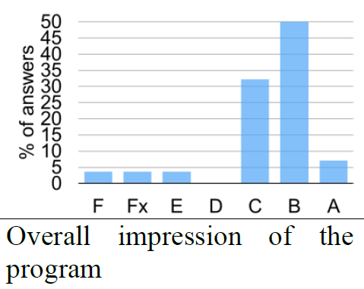
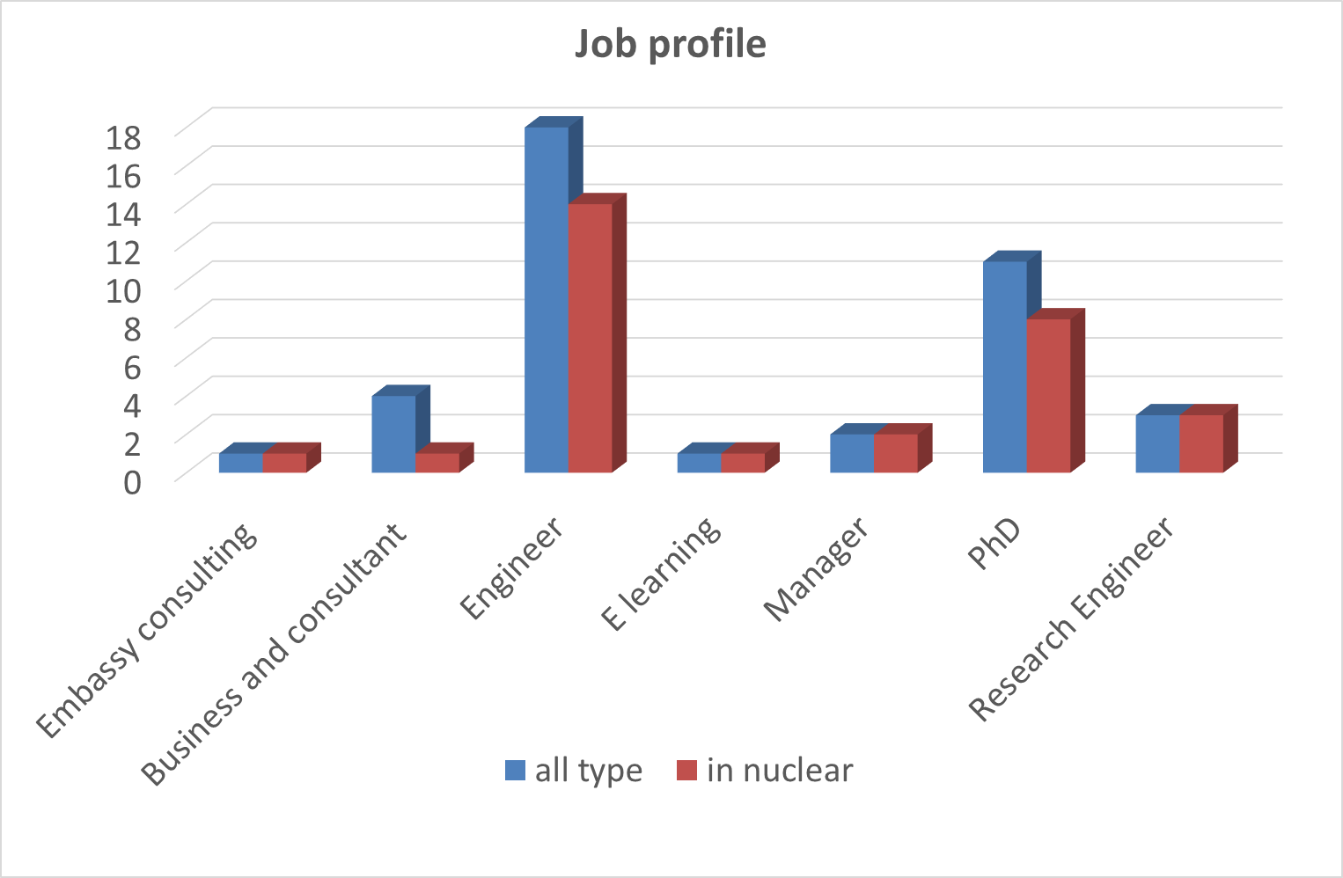
International students
Small groups (20-30) international students from europe (40%) and other
world countries (60%)
Good feedback from students
Own surveys at each university, full programme survey (consortium and master school). Master has impact on the career of students
“To be honest i didn't think i would enjoy that much. Putting EDF and CEA modules is a real plus and i am really glad that i had this possibility. Good cohesion in the class”
Very good employability of Students in nuclear sector or not. Important role of industrial and academic partners. One startup created (innovation fund from Danemark), founder is Forbes 30 under 30…
5

Slide 6
How does EMINE works?
Rely on 4 different Master Programmes:
Master in Nuclear Energy Engineering at KTH (Royal Institute of Technology - Stochholm)
Master in Nuclear Engineering at UPC (Universitat Politècnica de Catalunya – Barcelona)
Material for Nuclear Energy at G INP (Institut Polytechnique de Grenoble)
Master In Nuclear Energy at UPSay (Université Paris Saclay)

Slide 7
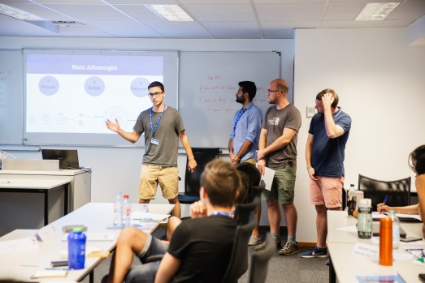
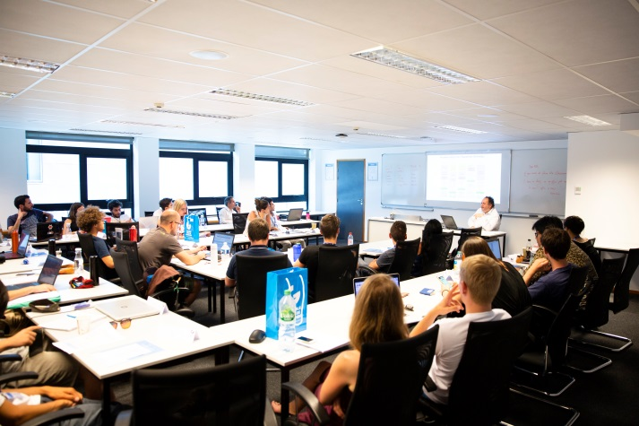
How does EMINE works?
A Summer School organised by ESADE Business school, Barcelona
Focus on Innovation, Entrepreneurship, Management
Special guests from Industry
Experiential learning design:

Slide 8
How does EMINE works?
A Strong participation of Industrials:
Courses done by EDF, ENDESA, CEA
On-site visits on strategic locations:
SKB’s Oskarshamn storage facility
CEA Cadarache
EDF’s Material Aging institute
Framatome’s St Marcel Factories

Slide 9
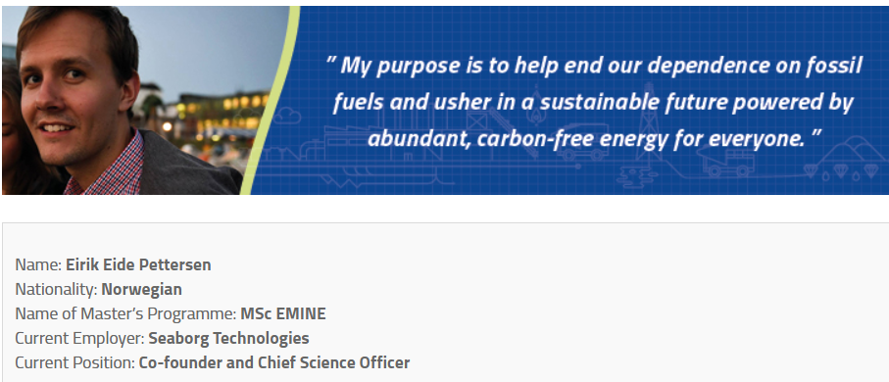
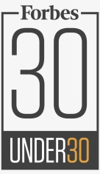
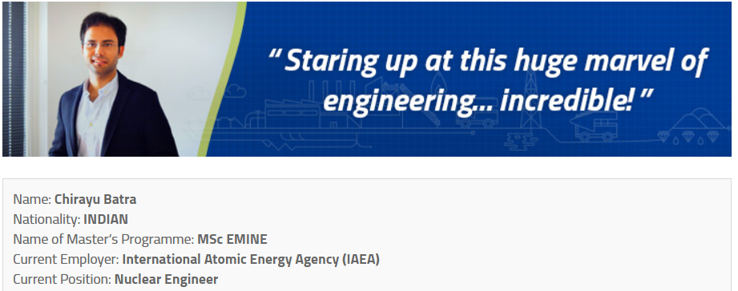
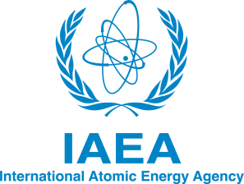
Student stories

Slide 10
Contacts :
Emilie Ferrié: emilie.ferrie@grenoble-inp.fr
Fanny Hébert: fanny.hebert@grenoble-inp.fr
Luc Salvo: luc.salvo@grenoble-inp.fr
Web site
www.innoenergy.com/emine
Fees: 18 000 euros / year
Grants and fee waiver available for best students

